Slide 1
Shell and Bootstrapping
Karl Shifflett
Program Manager, Microsoft patterns & practices

Slide 2
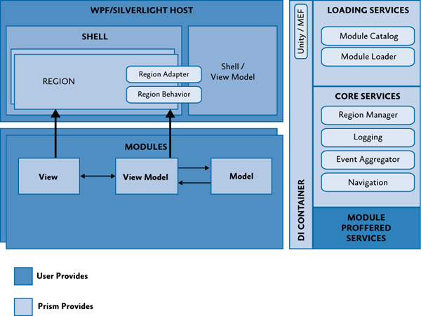
Prism Applicaiton

Slide 3
WPF Shell
Is the application root object
The shell is a Window object
It defines the top-level structure of the application
It’s in the application.exe assembly
The application.exe assembly is not required to reference satellite module assemblies
The application.exe assembly can contain modules

Slide 4
WPF Shell – cont.
Has no knowledge of, or dependencies on application modules
Is created and shown by the bootstrapper
App.xaml StartUpUri is not used.

Slide 5
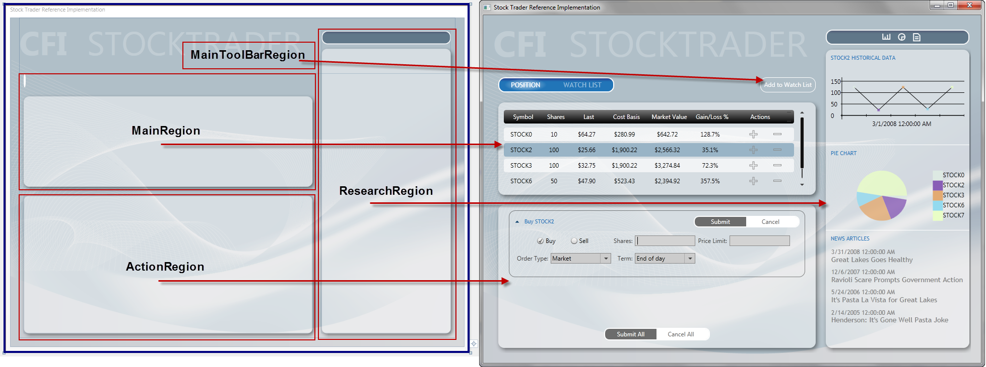
Stock Trader RI Shell
Shell defines layout and top-level regions
Regions are loaded during application startup as opposed to run-time loading based on user actions

Slide 6
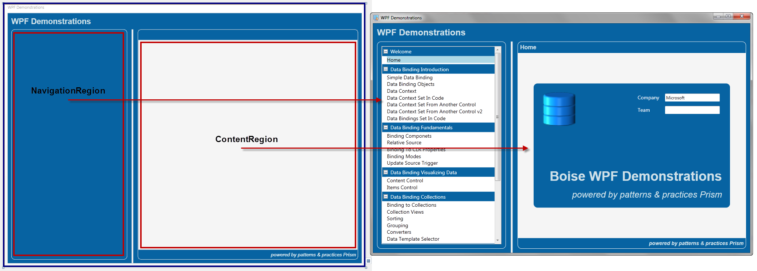
WPF Demonstration Shell
Shell defines layout and top-level regions
Navigation region loaded during startup
Navigation region injects (navigates) modules into the Content region
Notice the Content Region’s boundaries

Slide 7
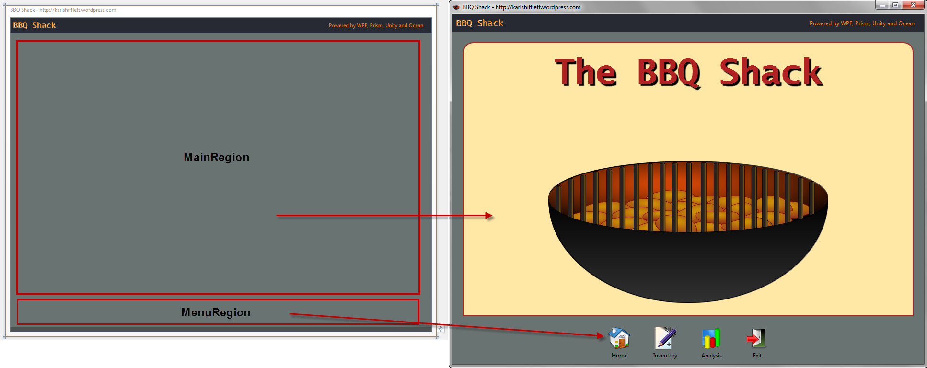
BBQ Shack Shell
Shell defines layout and top-level regions
Menu region loaded during startup
Menu region injects (navigates) modules into the Main region

Slide 8
Demo
Shell
Wpf.Demonstrations
AnimationContextControl

Slide 9
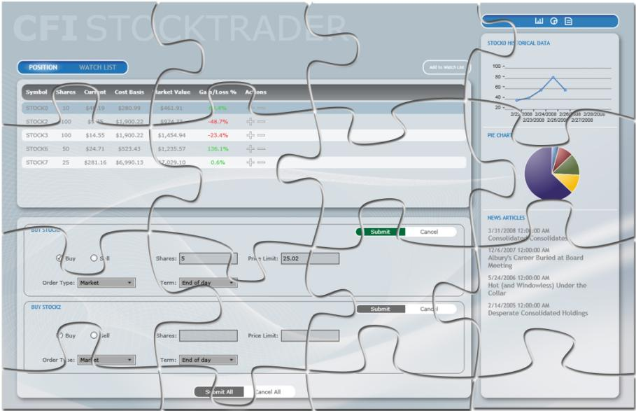
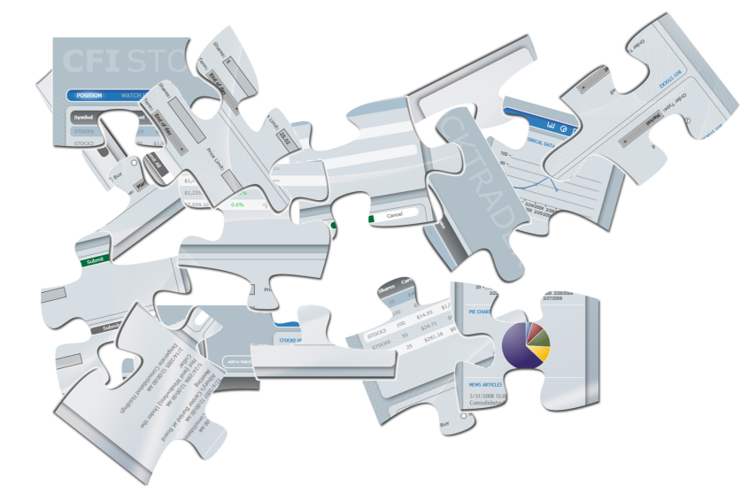
Applications are Composed during Bootstrapping

Slide 10
Bootstrapper
Is responsible for initialization
Automatically initializes Prism components
Gives control over how the application is initialized and configured
Located in the application.exe assembly
Is instantiated and run from the OnStartUp method in either App.xaml.cs or Application.xaml.vb

Slide 11
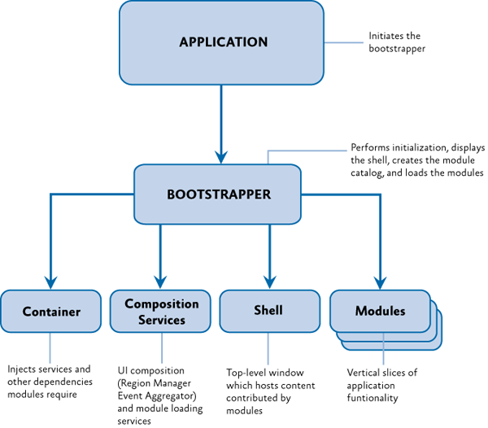
Bootstrapper

Slide 12
Bootstrapping Process
Create ILoggerFacade (defaults to debug output window)
Create and configure a module catalog
Create and configure the container
Automatically registers Prism library components
Registers user defined types
Configure default region adapter mappings
Configure default region behaviors
Register framework exception types
Create the shell
Initialize the shell
Initialize the modules

Slide 13
Default Logger Output on Startup
DEBUG: Logger was created successfully.. Priority: Low. Timestamp:2011-06-26 15:15:45Z.
DEBUG: Creating module catalog.. Priority: Low. Timestamp:2011-06-26 15:15:45Z.
DEBUG: Configuring module catalog.. Priority: Low. Timestamp:2011-06-26 15:15:45Z.
DEBUG: Creating Unity container.. Priority: Low. Timestamp:2011-06-26 15:15:45Z.
DEBUG: Configuring the Unity container.. Priority: Low. Timestamp:2011-06-26 15:15:45Z.
DEBUG: Adding UnityBootstrapperExtension to container.. Priority: Low. Timestamp:2011-06-26 15:15:45Z.
DEBUG: Configuring ServiceLocator singleton.. Priority: Low. Timestamp:2011-06-26 15:15:45Z.
DEBUG: Configuring region adapters.. Priority: Low. Timestamp:2011-06-26 15:15:45Z.
DEBUG: Configuring default region behaviors.. Priority: Low. Timestamp:2011-06-26 15:15:45Z.
DEBUG: Registering Framework Exception Types.. Priority: Low. Timestamp:2011-06-26 15:15:45Z.
DEBUG: Creating the shell.. Priority: Low. Timestamp:2011-06-26 15:15:45Z.
DEBUG: Setting the RegionManager.. Priority: Low. Timestamp:2011-06-26 15:15:45Z.
DEBUG: Updating Regions.. Priority: Low. Timestamp:2011-06-26 15:15:45Z.
DEBUG: Initializing the shell.. Priority: Low. Timestamp:2011-06-26 15:15:45Z.
DEBUG: Initializing modules.. Priority: Low. Timestamp:2011-06-26 15:15:46Z.
DEBUG: Bootstrapper sequence completed.. Priority: Low. Timestamp:2011-06-26 15:15:46Z.

Slide 14
Demo
Bootstrapper
StockTraderRI
Wpf.Demonstrations; Post Build Event, References Copy Local, demonstrate logging from module using ILoggerFacade

Slide 15
Contact
Twitter: @kdawg02
Blogs
http://karlshifflett.wordpress.com/
http://blogs.msdn.com/b/kashiffl/
http://blogs.msdn.com/b/wpfsldesigner/
Links
http://compositewpf.codeplex.com/
http://msdn.microsoft.com/en-us/practices/default.aspx

Slide 16


